Slide 1
GeoData WS2023-2024 Group S
Amr-Mohamed-Abdeldayem Abdelkhalek, 31309

Slide 2
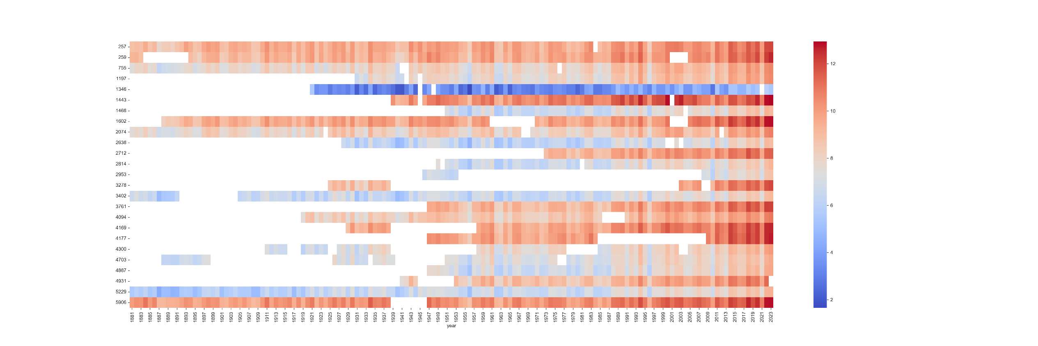
1. Warming Stripes

Slide 3
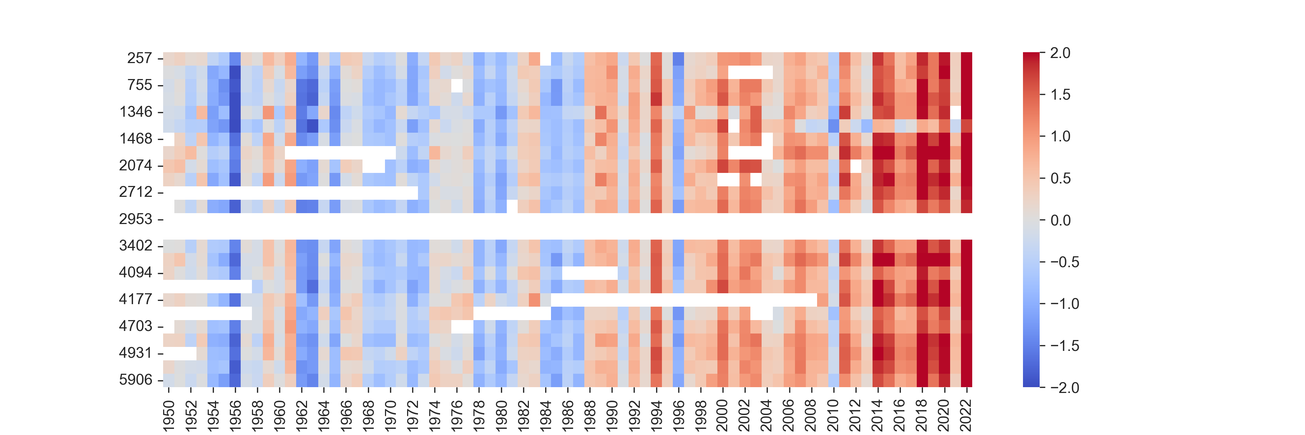
1. Warming Stripes

Slide 4
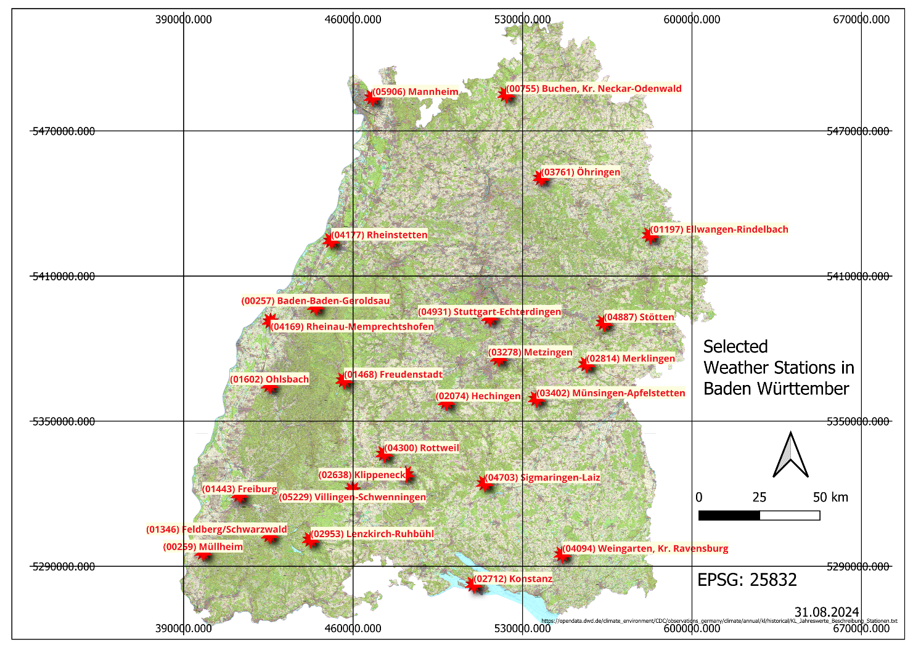
1. Warming Stripes

Slide 5
2. Digitization: Burial Mounds in Uedemer Hochwald
Average of 58 cm s difference
All the details are in the Markdown files.

Slide 6
3. OpenHygrisC Nitrate Data: Create a Movie with the QGIS Temporal Controller Connected to PostgreSQL / PostGIS
Done Successfully and the video was produced.

Slide 7
4. FREE EXERCISE
I tried to first do an exercise that matches the red sea oil rigs with the geology heated undersurface. Searched for 4 hours and found no data.
Tried to do a similar approach of exercise 2 but with the pyramids .. But could not find DTM/DEM files of HQ enough to study the Lidar images. I used the ones produced from Nasa via their SRTM downloader plugin.

Slide 8
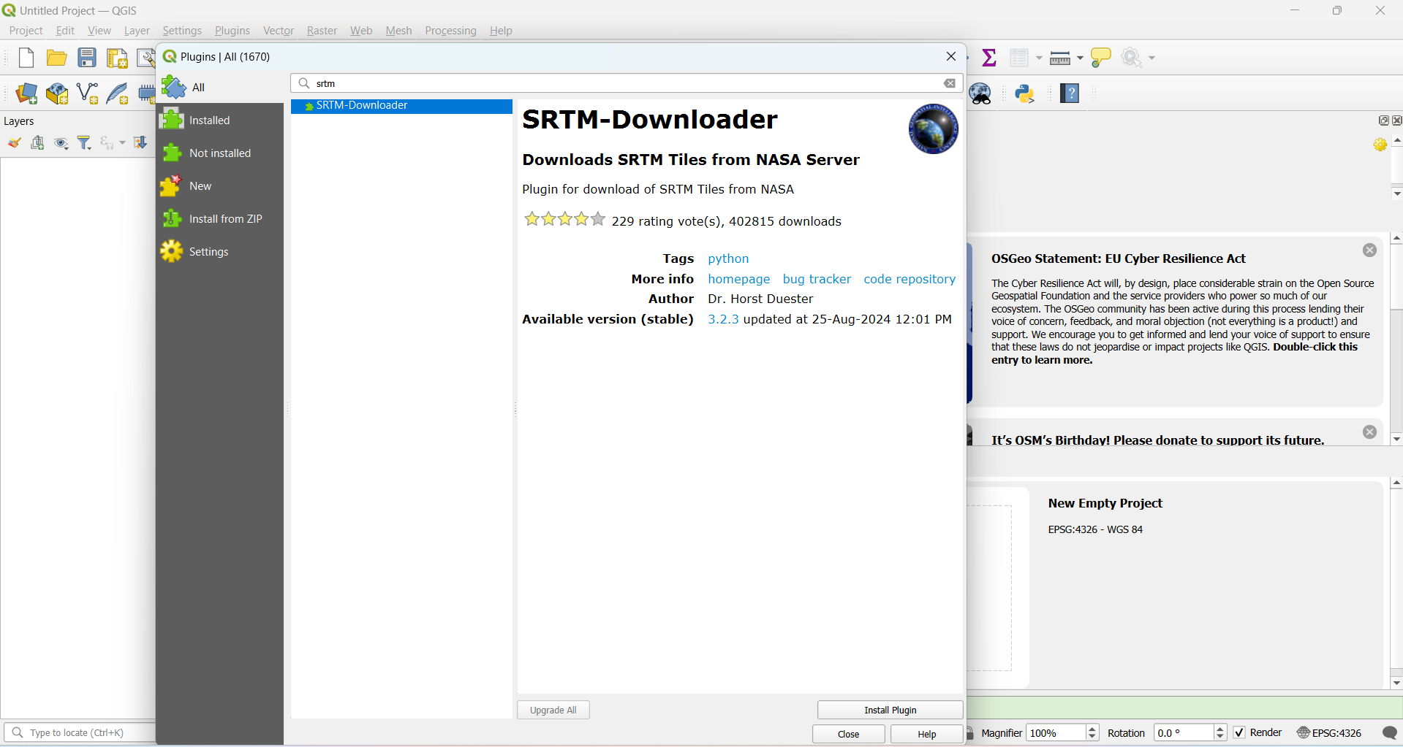
4. FREE EXERCISE

Slide 9
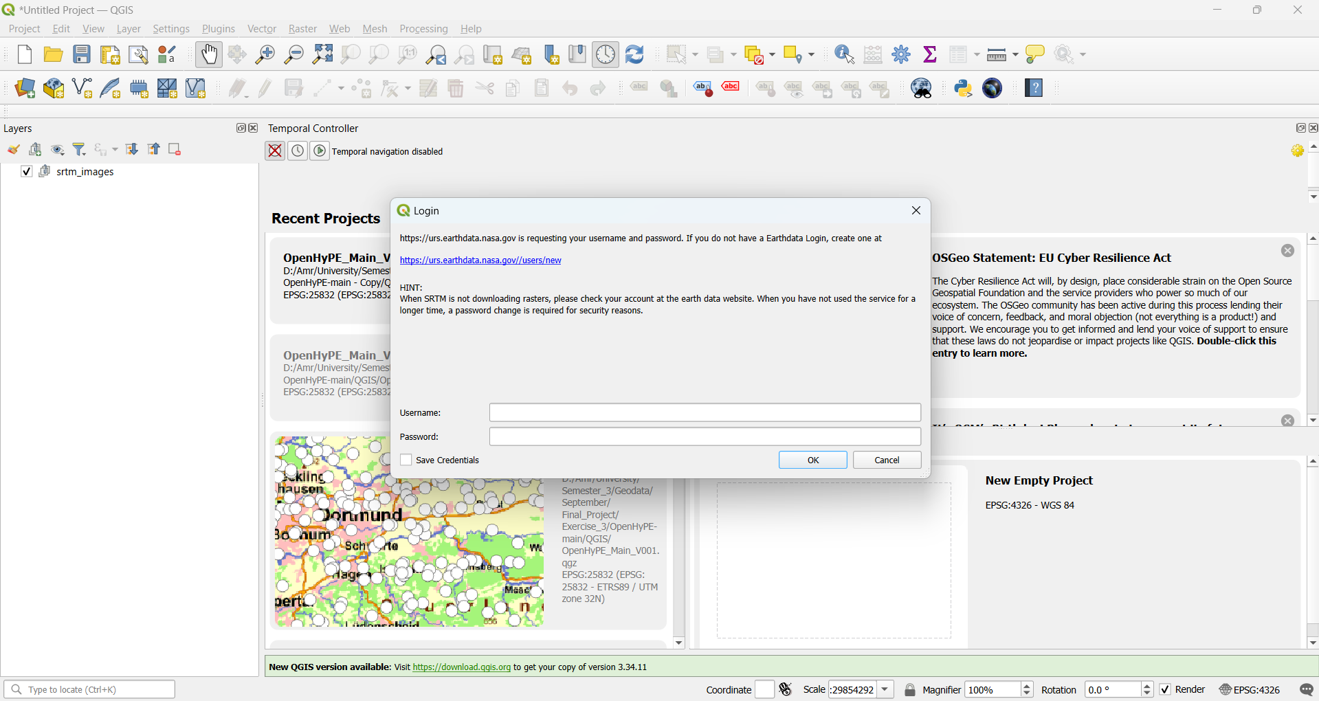
4. FREE EXERCISE

Slide 10
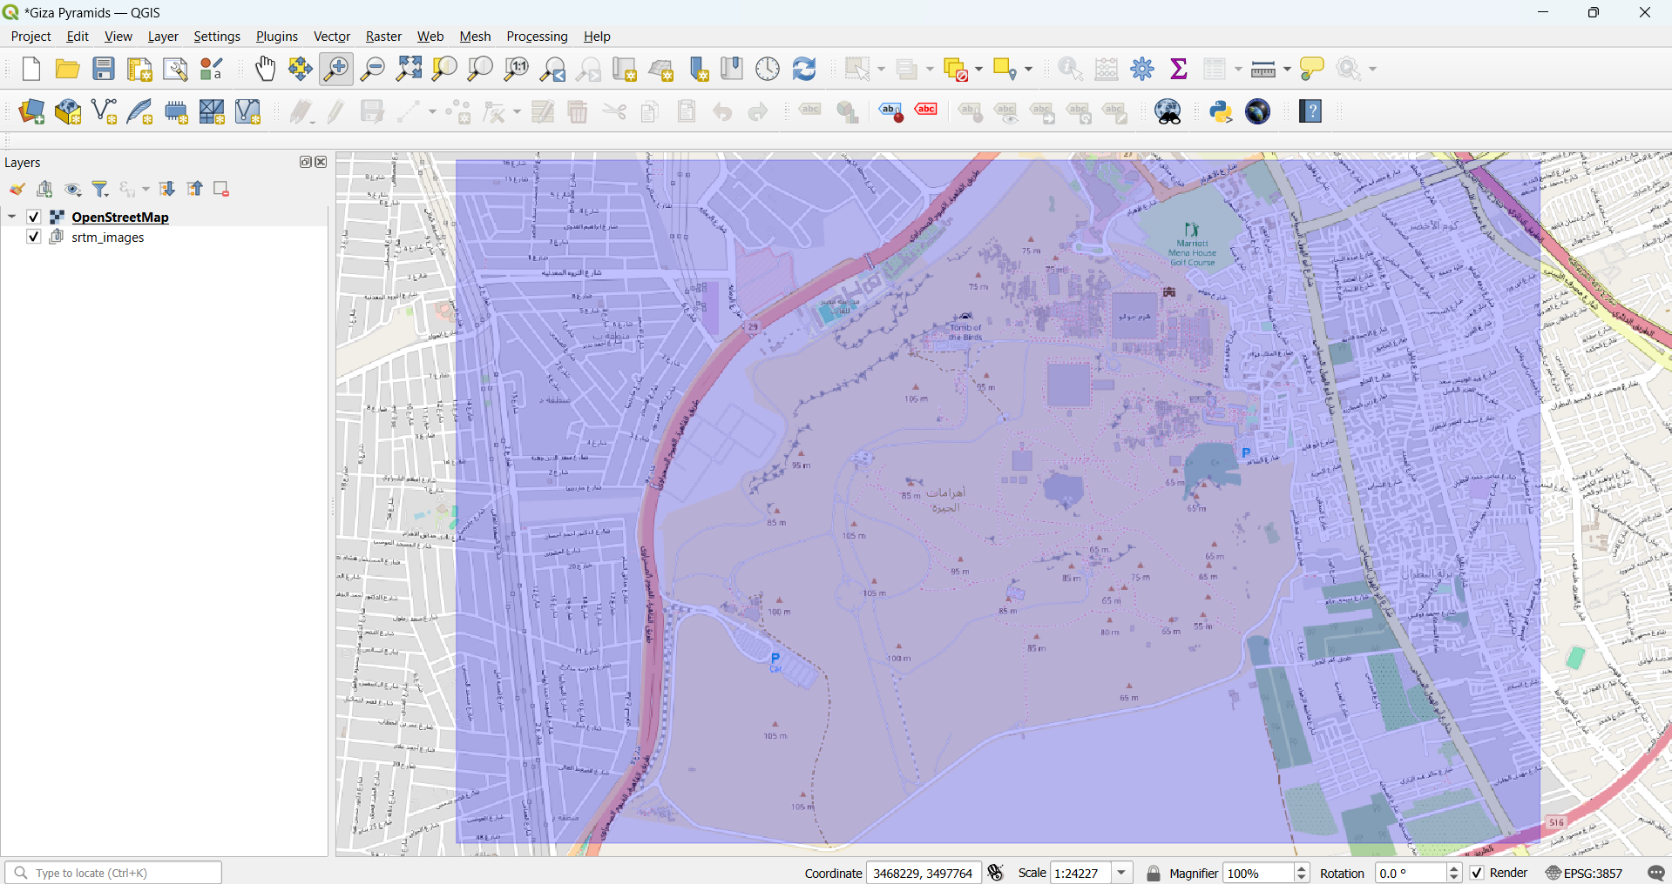
4. FREE EXERCISE

Slide 11
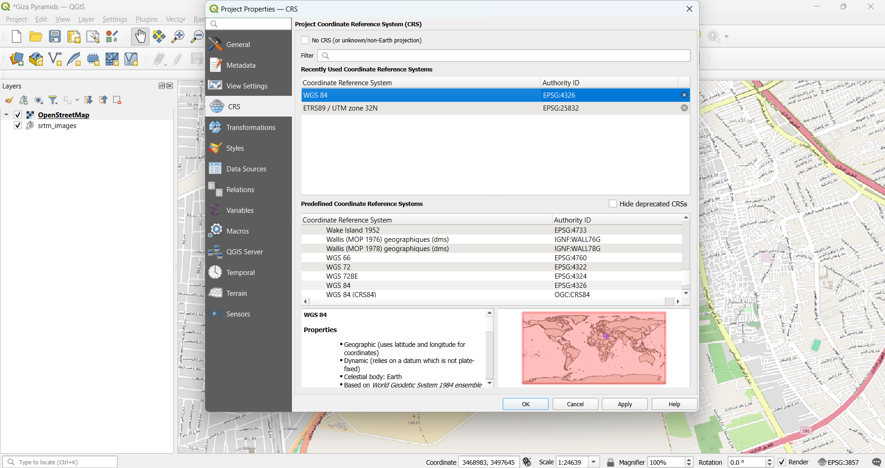
4. FREE EXERCISE

Slide 12
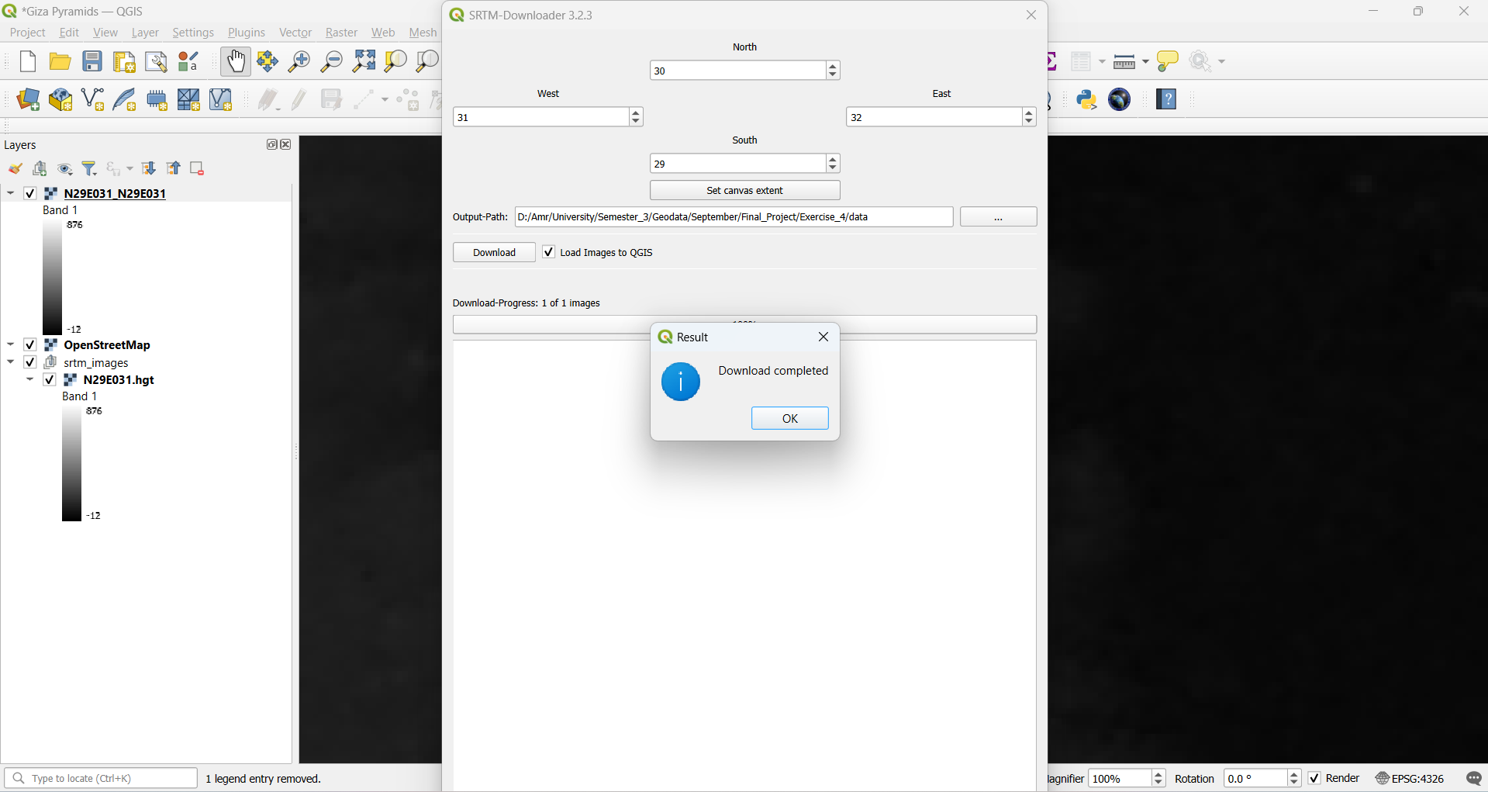
4. FREE EXERCISE

Slide 13
<matno>: Your Personal View
Biggest challenges?
Doing the exercise alone, after the others had left. Many errors I had to learn a lot to fix and the 3rd task would have been much easier if it was more covered in the lectures but I understand that my colleagues could be slow.
Lessons learned?
To respect the process of learning because there was a huge difference between how I was handling errors from the beginning and after .. I was expecting every possible and potential error after learning... There are no shortcuts.
Whatever you want to say related to course, …
The course is really rich and good I wish there were an advanced elective for it.

Slide 14
<matno>: Self-Assessment, Part 1 (give short answers)
What is your role in the group?
I was alone so (everything)

Slide 15
<matno>: Self-Assessment, Part 2 (On a scale from 1 (poor) to 5 (very good))
What is your personal knowledge gain?
5
How do you rate your commitment?
4.9
How difficult is your task?
3 all was fair except for the 3rd exercise that was really challenging

